Slide 1

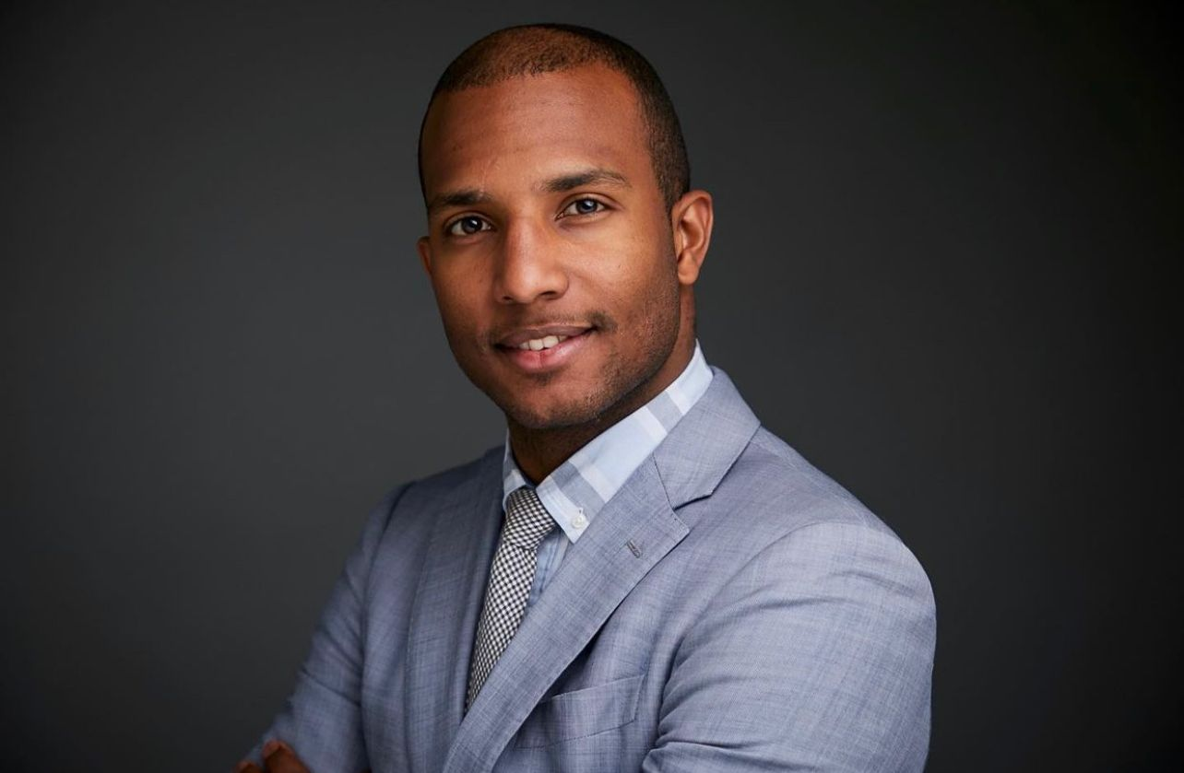

Fraud Detection and Prevention
DS4A 2023 - Data Skills For All
Finance Challenge for Data Analysts
Juan River Veloz Reyes

Slide 2



BACKGROUND
In 2022, consumers reported mind-boggling losses of nearly $8.8 billion to scams and fraud, as revealed by the Federal Trade Commission (FTC)
Credit card fraud. It's the arch-nemesis of financial stability, causing over $180 million in annual losses and keeping 26% of the adult U.S. population on high alert
Notes:
River

Slide 3


Goal
Using the provided dataset and additional data you may find on your own, develop a set of insightful data visualizations that shed light on patterns and trends related to financial fraud. Your visualizations should aim to deliver actionable insights to stakeholders, enabling them to take proactive measures against fraud.
Notes:
River

Slide 4
PREPROCESSING
Analyzed all the essential features
Decide which columns we would drop and why
Change Data Type
Manipulating the Data
Notes:
River

Slide 5
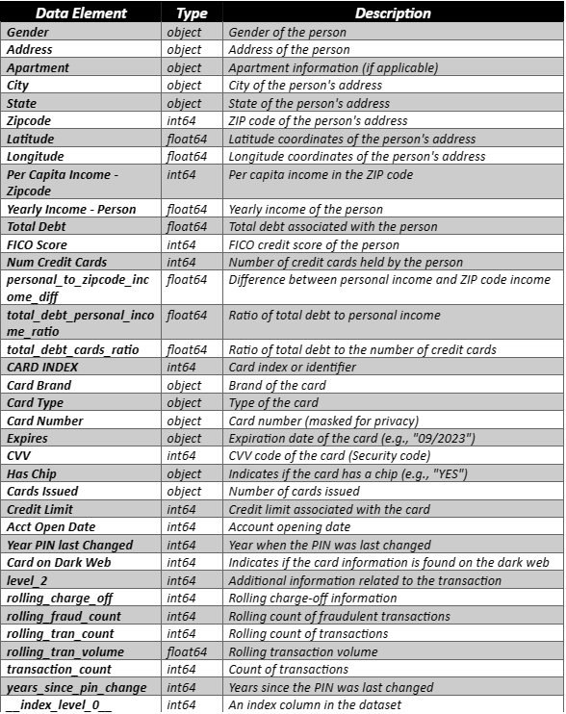
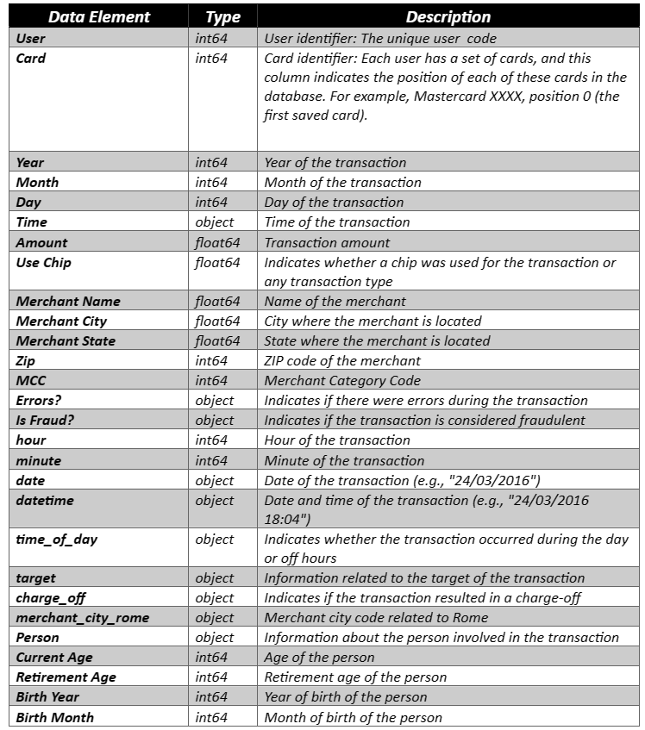
About our Credit Card credit_card_data_da.parquet This table contains records for all user’s information. 6’877,837 rows & 64 columns. Size: 217 MB
Notes:
River

Slide 6

Data Cleaning Process
Notes:
River

Slide 7
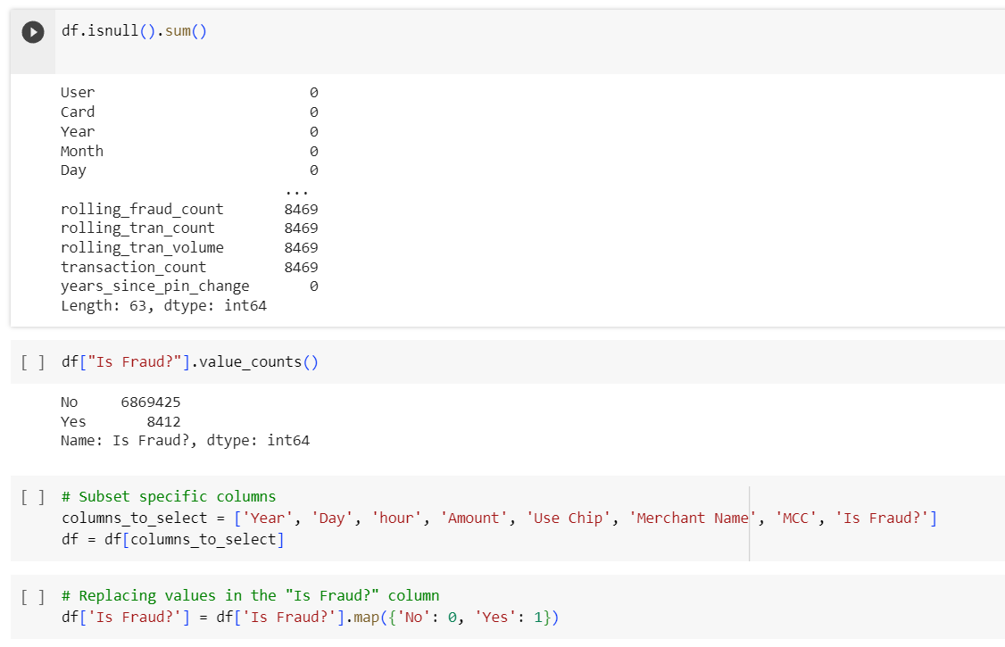

Slide 8


Exploratory DATA ANALYSIS

Slide 9
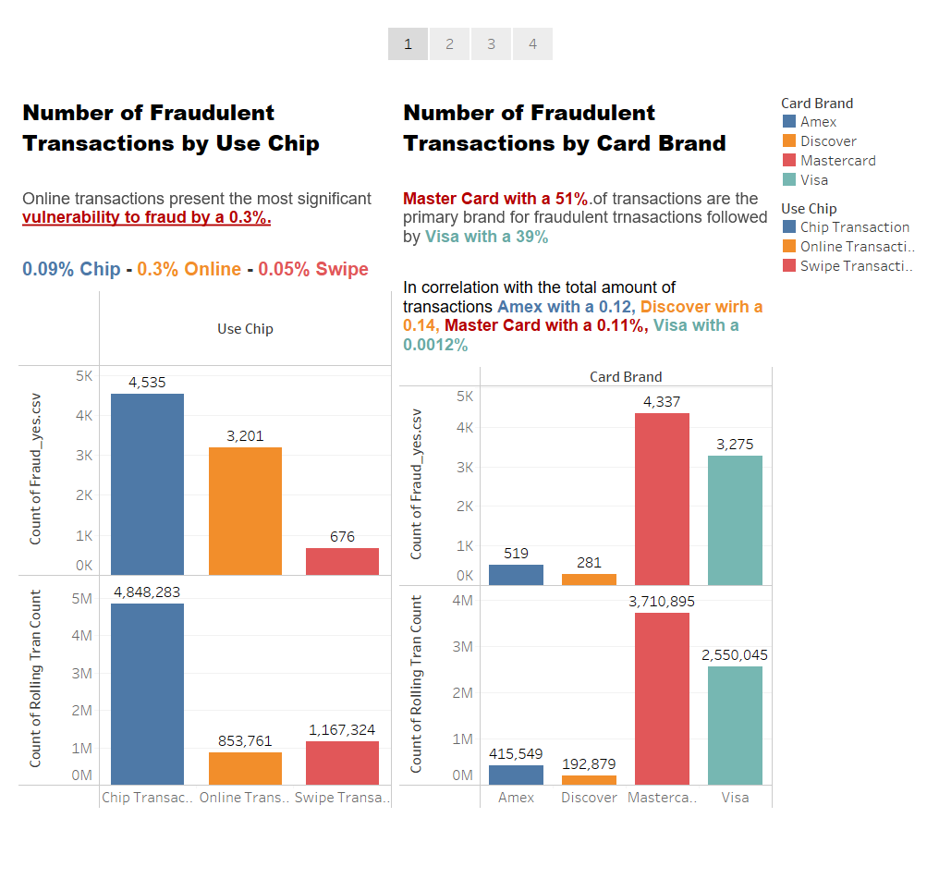
https://public.tableau.com/app/profile/juan.river.veloz.reyes/viz/FraudDetectionandPrevention-DS4A/FraudDetectionandPrevention#1

Slide 10
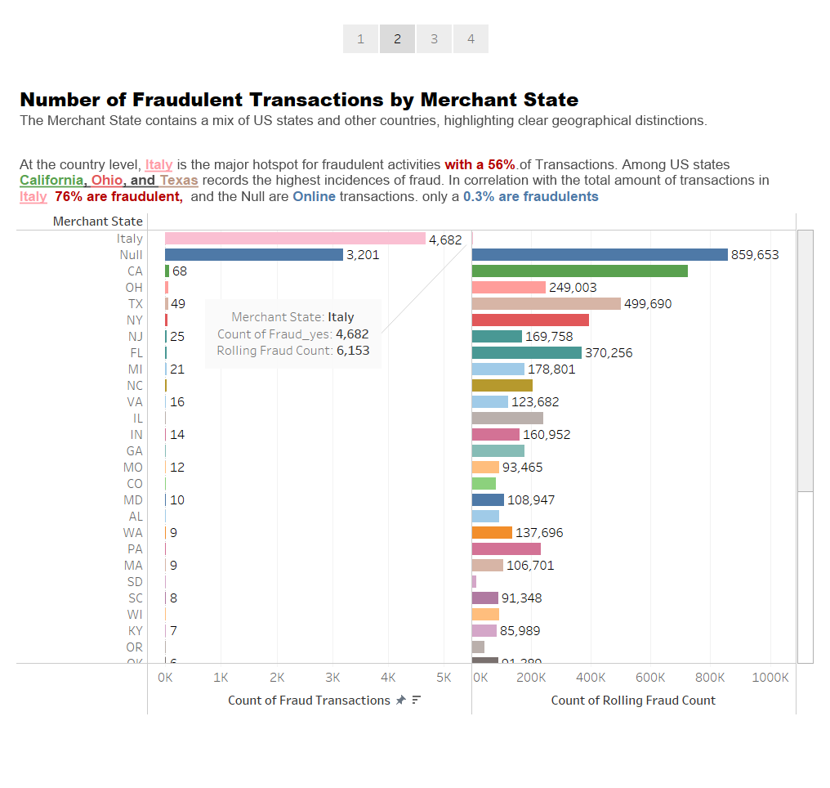

Slide 11
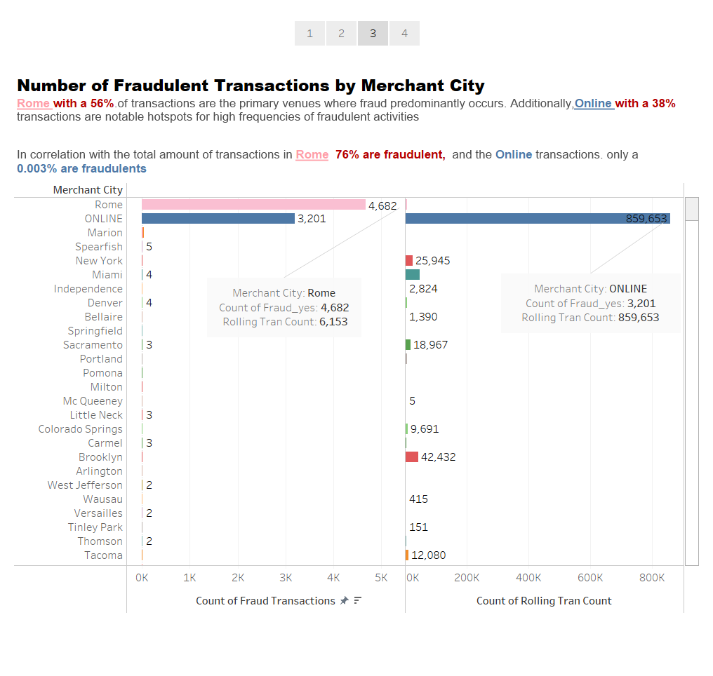

Slide 12
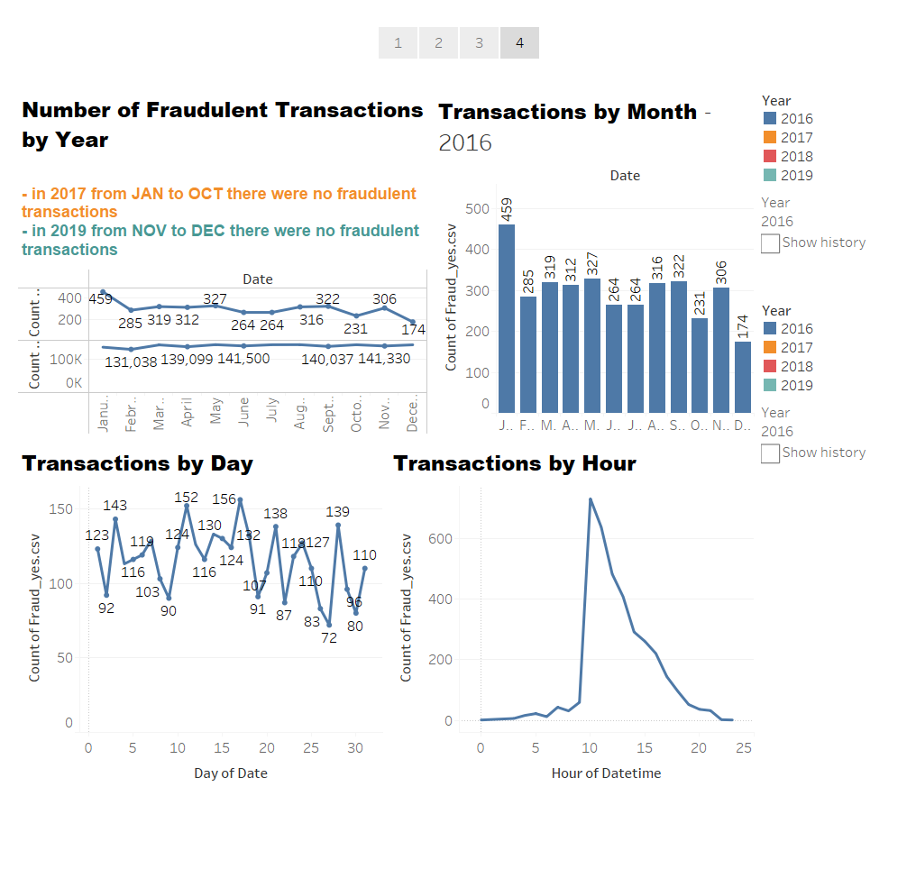

Slide 13

Predictive Modeling with Random Forest

Slide 14
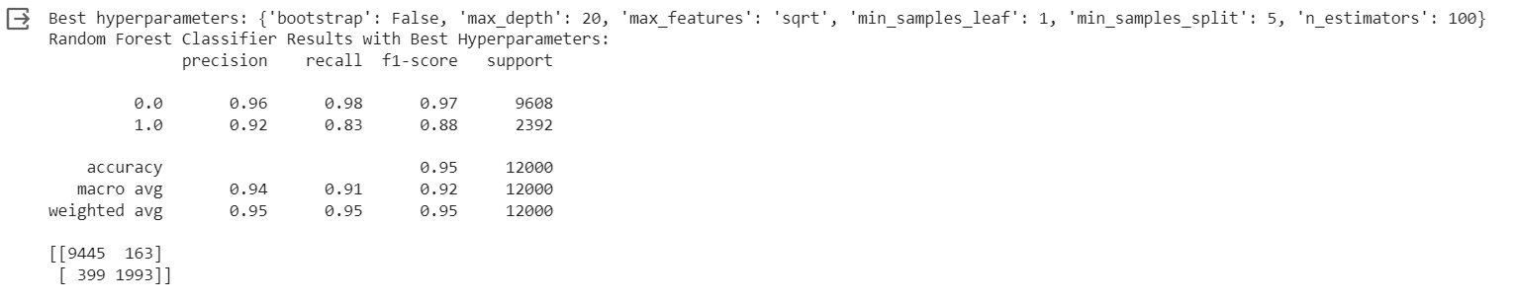
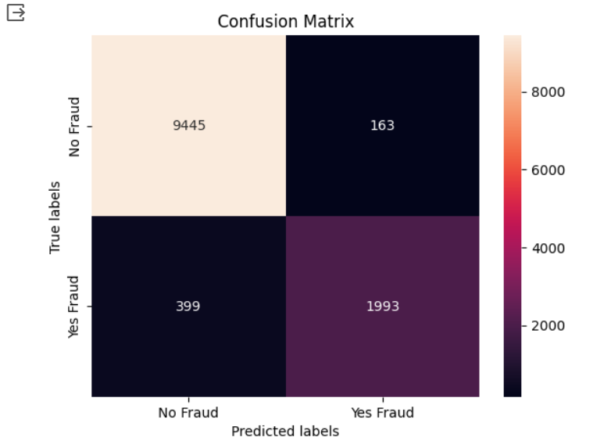
Interpretation:
Precision: A precision of 0.92 for class 1 means that 92% of the predicted fraud cases were actually fraudulent.
Recall: A recall of 0.83 for class 1 means that the model identified 83% of the actual fraudulent transactions.
F1-score: An F1-score of 0.88 indicates a good balance between precision and recall.
The model achieved high accuracy (95%) and performed well in classifying non-fraudulent transactions (class 0). And showed relatively higher recall (98%) for non-fraudulent transactions (class 0).
Notes:
Precision:
Precision metric is the ratio of True Positives to all Positives in its most basic form. That'd be the percentage of transactions that we correctly identify as being fraud out of all of the transactions that have it for our issue statement.
Precision = True Positive/ True positive + False positive
Recall:
The recall is a measure of how well our model detects True Positives. As a result, recall informs us how many transactions we accurately recognize as fraud out of all those who have it.
Recall = True Positive/ True Positive + False positive
Accuracy:
Now we'll look at one of the most basic measures of them all: Accuracy. The ratio of the overall number of right forecasts to the overall number of predictions is known as accuracy.
Accuracy= True Positive + True negative/ True positive +False positive+ True negative +False negative
F1 score:
This F1 score is the harmonic mean between recall and precision values and the formula is given below
F1 score= 2* Precision * Recall/Precision + Recall

Slide 15
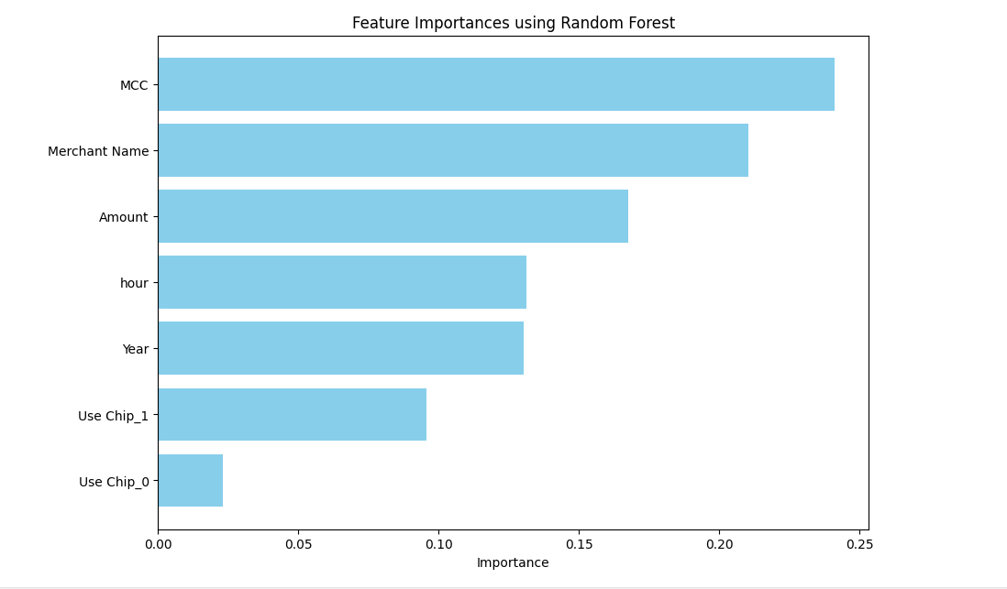
Extracting feature importances from the best random forest model

Slide 16

Insights

Slide 17
Based on the feature importance scores, the three top most important features for predicting fraud transactions are:
MCC: Merchant Category Code And Merchant Name
Insight: Certain types of merchants or industries may be more susceptible to fraudulent activities than others. Some businesses are at a higher risk of fraud than others. This can happen because they handle a lot of transactions, sell expensive items, or offer products that are popular in the illegal market. It's important to know which businesses might be more vulnerable to fraud
Amount: transaction amount
Insight: Fraudsters often use the size of a transaction to their advantage. They might make big purchases to get as much as they can before the card is reported stolen. Alternatively, they could make small purchases to check if the card works without attracting attention. So, if you notice transactions much bigger or smaller than your usual spending, it's a warning sign.

Slide 18
Recommendations

Slide 19
Recommendations
For MCC and Merchant Name:
Businesses and credit card companies need to pay extra attention to certain types of stores that are more likely to face fraud. They should keep a close watch and put extra safety measures in place for these places. It's also a good idea to educate people about being careful when shopping in these specific areas.
For Amount:
Create a smart system that spots really high or low transactions compared to what a user usually spends. If something unusual happens, let users know about it

Slide 20



